Slide 1

UrbanCart Superstore Data Analysis Project
A comprehensive Python-based analysis uncovering profit drivers and performance insights across products, regions, and customer segments
PYTHON ANALYTICS
PANDAS, MATPLOTLIB
Debdatta Mukherjee

Slide 2

Business Problem & Objective
The Challenge
Our Approach
Despite steady sales growth, UrbanCart Superstore faces inconsistent profitability across product categories, regions, and customer segments. The business requires actionable insights to identify profit drivers and margin leakages for sustainable growth.
Analyze retail sales data to understand business performance patterns
Identify revenue, profit, and loss trends across dimensions
Compare performance across regions, categories, and customer segments
Deliver data-driven recommendations for strategic decision-making
This dataset contains cleaned retail transaction data where each row represents an individual order line item, including product details, customer segments, geographic regions, sales metrics, profit, discounts, and shipping modes.

Slide 3
Dataset Overview
Data Source
Volume
Dataset downloaded from GitHub repository
9,994 transaction records across 25 data columns
Data Structure & Key Columns
Order Information:
Product Information:
Row ID, Order ID, Order Date, Ship Date
Product ID, Category, Sub-Category
Delivery Days, Ship Mode
Product Name
Customer Details:
Financial Metrics:
Customer ID, Customer Name, Segment
Sales, Quantity, Discount, Profit
Geographic Data:
Profit Margin
Country, City, State, Postal Code, Region
Time Dimensions:
Months, Years

Slide 4

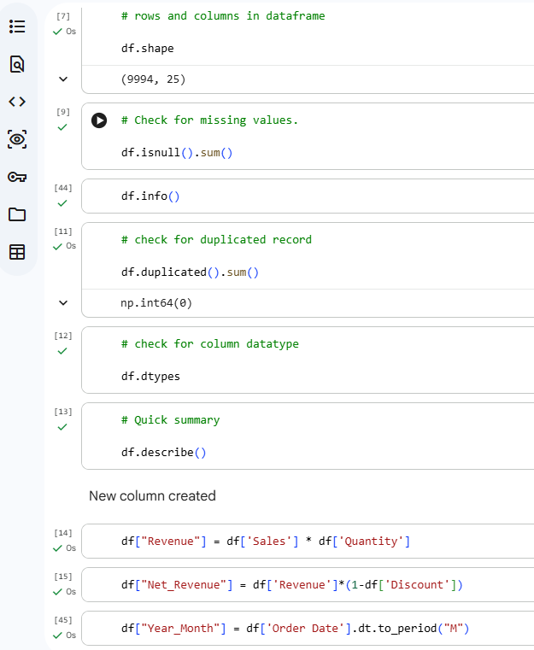
Data Preparation & Engineering
01
Data Type Validation
Verified and standardized column data types for consistent analysis
02
Date-Time Conversion
Converted date-time columns into proper datetime format for temporal analysis
03
Duplicate Detection
Checked for and addressed duplicated values to ensure data integrity
04
Statistical Summary
Generated quick summary statistics of numeric columns to identify patterns and outliers
Calculated Columns Created
Revenue
Formula: Sales × Quantity
Net Revenue
Formula: Revenue × (1 − Discount)
Year Month
Extracted from Order Date for monthly and MoM calculations

Slide 5
Overall Business Performance
$9.9M
$286K
Total Revenue
Total Profit
Generated across all product categories and regions
Net profitability from all transactions
2.89%
37,873
Profit Margin
Units Sold
Overall profitability rate
Total product volume moved
Year-Over-Year Trajectory
December 2016 marked the highest performing month, achieving $511,540.46 in revenue and $17,885.31 in profit.
Both revenue and profit demonstrate consistent upward trends year-over-year, indicating solid business growth momentum despite margin compression challenges.

Slide 6
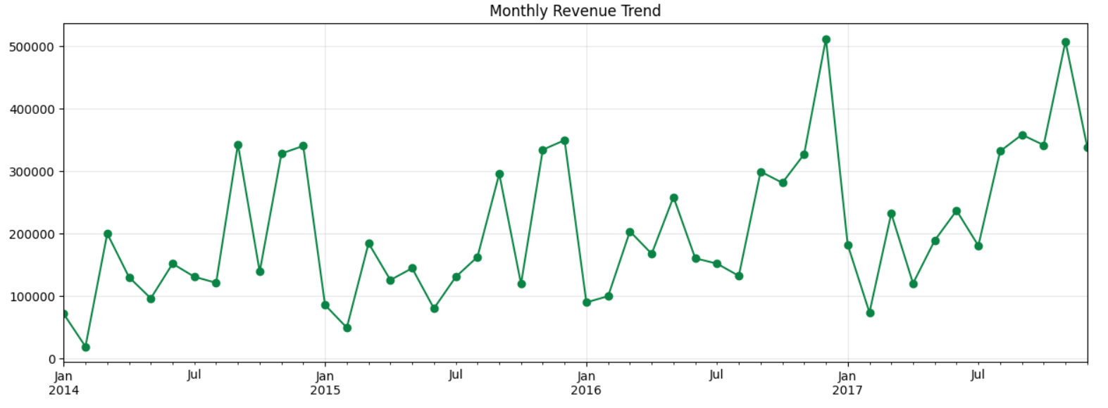
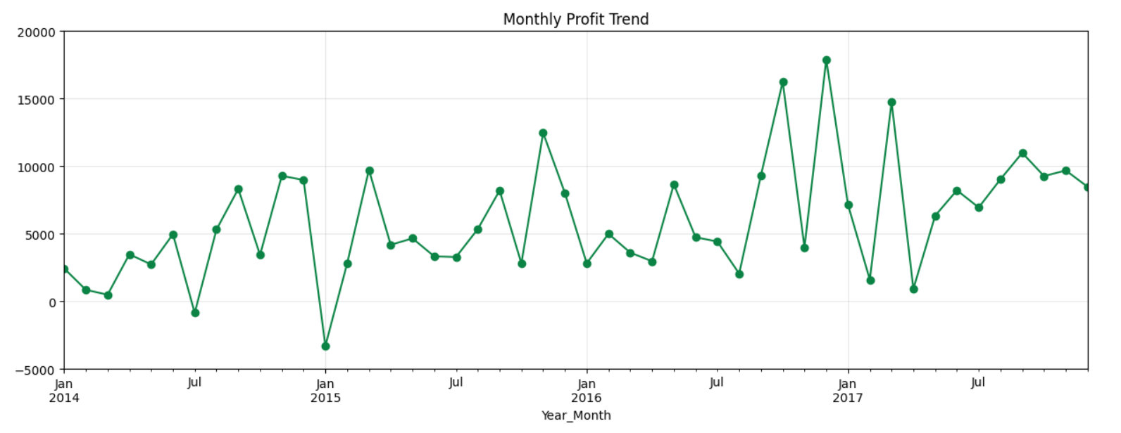
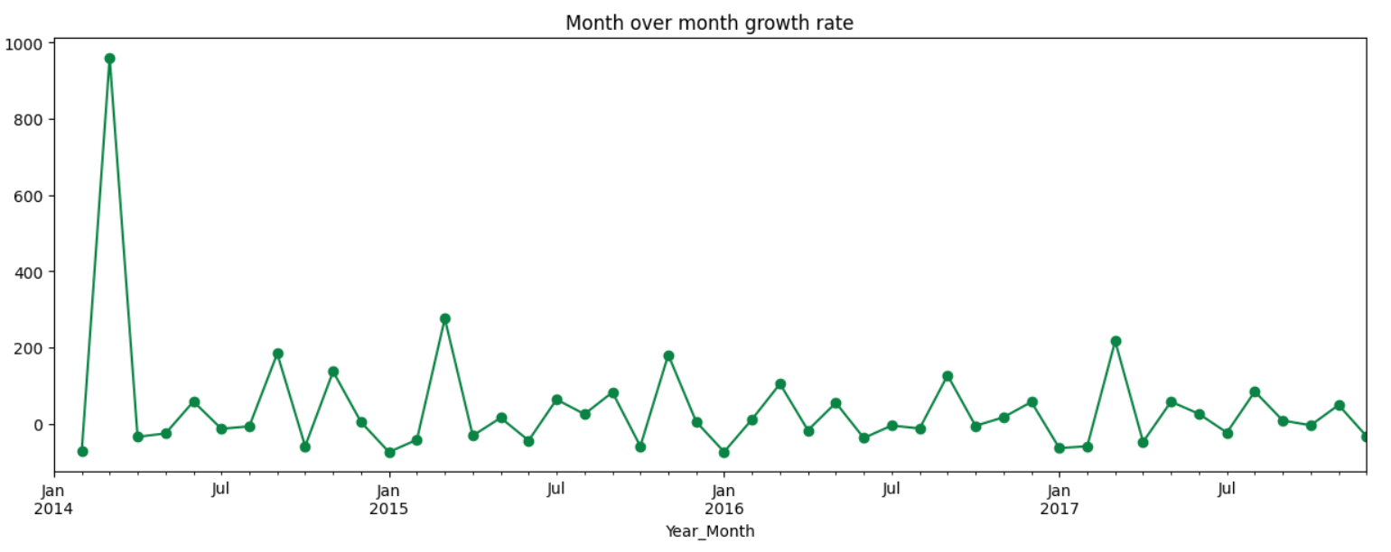
Trends

Slide 7
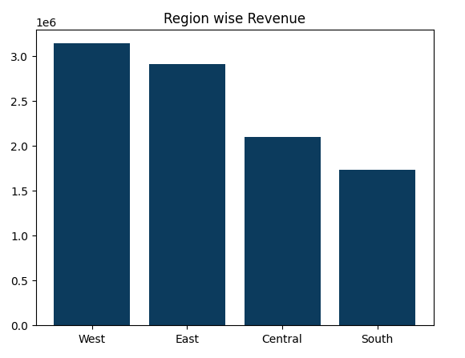


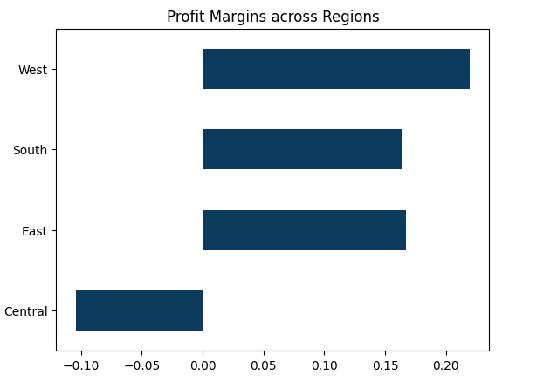



Regional & Market Analysis
West Region
Revenue: $3,142,034
Profit: $108,418.45
Profit Margin: 21.95% — Strongest performer with exceptional profitability
Central Region
Revenue: $2,099,688
Profit: Negative
Profit Margin: -10.41% — Critical concern requiring immediate corrective action
South Region
Revenue: $1,736,787
Profit: $46,749.43
Profit Margin: 16.35% — Solid performance with healthy profitability
East Region
Revenue: Significant contributor
Profit: Positive
Profit Margin: 16.72% — Consistent and reliable performance
The stark contrast between regions reveals significant opportunity for operational improvement, particularly in the Central region where losses are eroding overall profitability.

Slide 8

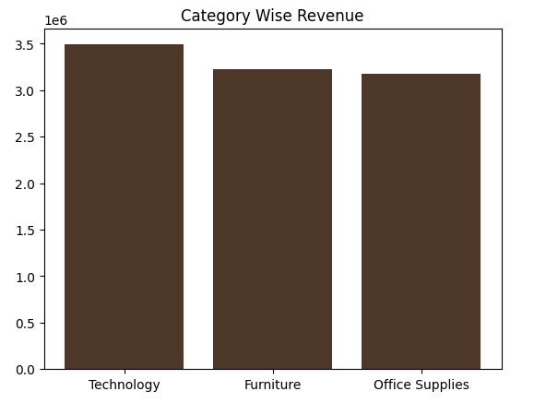


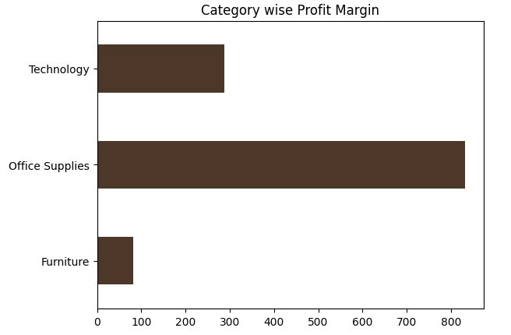

Product & Category Analysis
Category Performance Breakdown
Technology
Office Supplies
Revenue: $3,491,750
Revenue: Strong contributor
Profit Margin: 4.16%
Profit Margin: 3.86%
Highest revenue generator with strongest profitability
Healthy margins with consistent performance
Furniture
Revenue: Significant volume
Profit Margin: 0.57%
Lowest margin requiring strategic review

Slide 9




Strategic Recommendations
Customer-Centric Strategies
Implement tiered loyalty programs for top customers, offering exclusive benefits, early sale access, and personalized recommendations to drive retention and lifetime value.
Business Performance Optimization
Analyze December 2016's exceptional performance to identify repeatable peak-season strategies. Address the 2.89% overall margin through pricing optimization, supplier negotiations, and cost reduction initiatives.
Regional Performance Enhancement
Urgently investigate Central region's negative margin through comprehensive review of discount strategies, shipping costs, product mix, and competitive dynamics. Implement immediate corrective measures.
Product & Category Management
Double down on Technology and Office Supplies investments while conducting rigorous cost-benefit analysis for Furniture category. Consider selective SKU rationalization or pricing adjustments.
This analysis provides a foundation for data-driven decision-making to enhance UrbanCart Superstore's profitability and sustainable growth trajectory.

